Slide 1
Introduction to Machine Learning: Neural Networks and Deep Learning
June 8, 2017
Single Family Analytics

Slide 2
Google (Wiki) Definition: Artificial neural networks (ANNs) or connectionist systems are a computational model used in machine learning, computer science and other research disciplines, which is based on a large collection of connected simple units called artificial neurons, loosely analogous to axons in a biological brain.
Deep learning (also known as deep structured learning, hierarchical learning or deep machine learning) is the study of artificial neural networks and related machine learning algorithms that contain more than one hidden layer.

Slide 3
Rapidly Changing Role of Neural Networks within AI and Machine Learning (ML)
Increasing role of ML.
Significant number of successful
ML applications were NN-based
Deep NNs are at the core of many
practical ML applications.
Exponential growth of DNNs adoptation
in a wide range of applications
Domination of non-ML AI

Slide 4
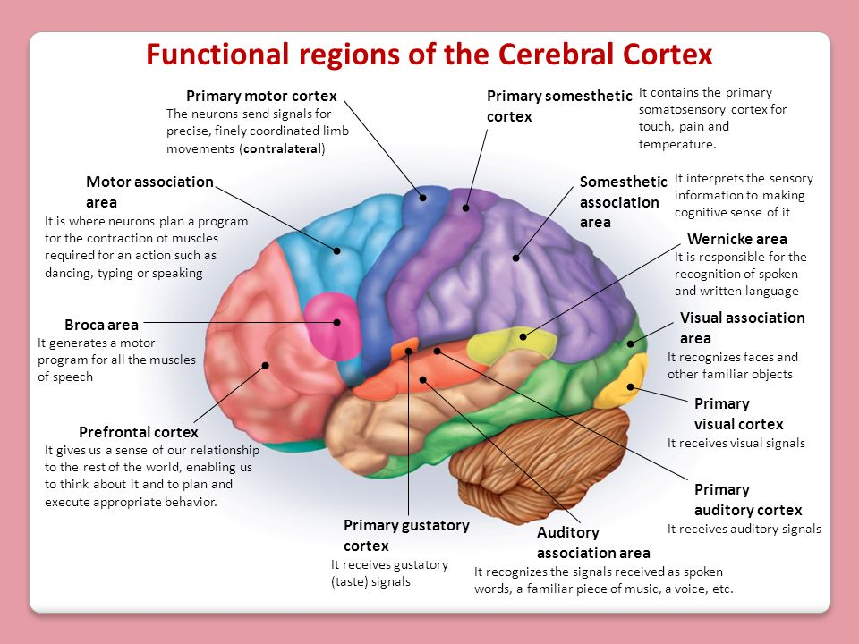
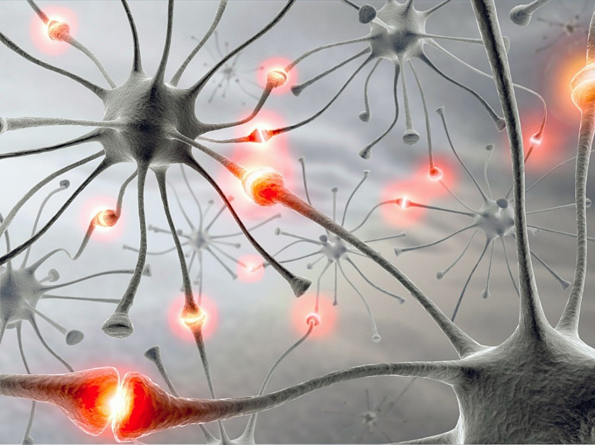
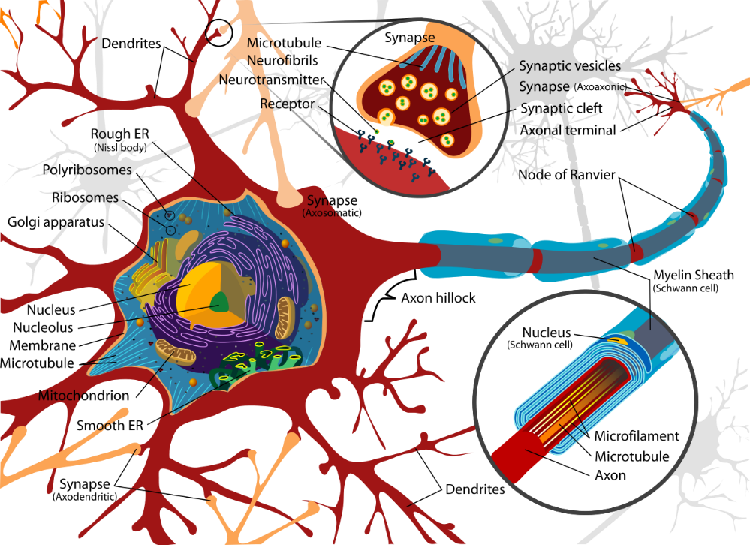
Why Neural Networks? Biological Origin
Human brain is one of the most fascinating and complex natural systems that is still far away from being fully understood, explained or replicated in-silico.
However, even our current knowledge about the brain and its capabilities shows very attractive features such as ability to effectively learn complex patterns and events, distributed storage of knowledge and memory, intrinsic parallelization, etc.
However, attempts to mimic these features inevitably lead to sever simplifications / approximations of the real brain and its functioning.
There two very distinct research and engineering efforts: (1) realistic simulation of brain activity and interaction of its components, and (2) mimic several key features in a very simplistic way to achieve desired computational and representational characteristics in the applied modeling framework.
Simulation models in the neuroscience attempt to capture structure and dynamics of the real brain as close as possible.
The main objective of ANNs is not to replicate brain functioning, but rather to “borrow” a few ideas to build much more simplified but practical machine learning algorithms.

Slide 5
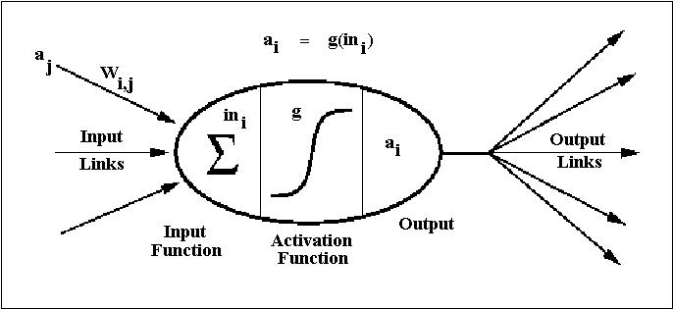
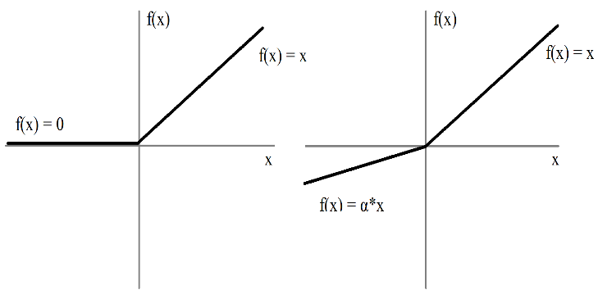
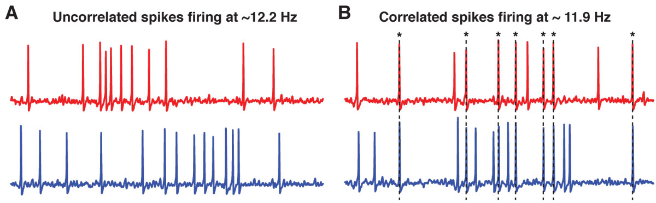
Artificial Neural Networks (ANNs)
ANNs are based on the following basic principles that are inspired by the real brain structure and functioning, but are drastically simplified:
NN consist of large collection of interconnected processing units – neurons.
Each neuron can receive inputs from one or many other neurons via connections – synapses.
If sum of all inputs becomes large than certain threshold, neuron fires, i.e. send signal to other neurons it is connected with.
NN learns by adjusting strength of each connection (synapse).
ANN ignores huge number of details present in the real brain. One of them is thought to be very important for information exchange and processing – neuron not just fire, but sends train of electrical spikes.
Sigmoid
ReLU (Rectified Linear Unit)

Slide 6
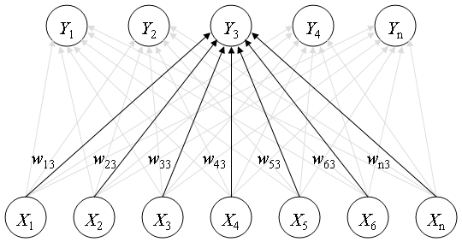
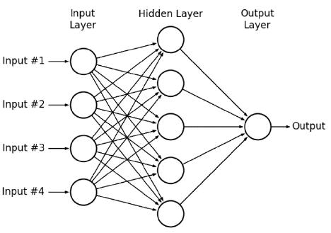
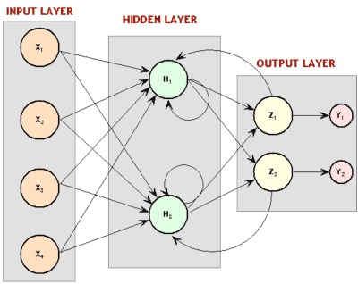
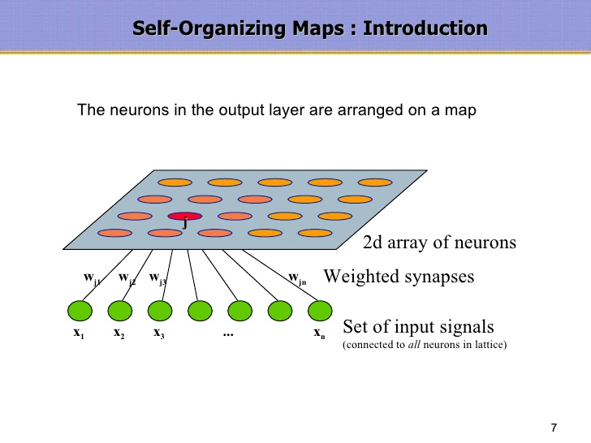
Types of Artificial Neural Networks
Over the more than half of century, large number of different ANN configurations with various training procedures and application areas have been proposed. Classification of ANN types includes (supervised / unsupervised), (feedforward / recurrent), etc. Generic examples of the most common types of ANNs are shown here.
Recurrent NN (RNN):
Unlike MLP, RNN can have feedback loops in different parts of the NN structure, including feedbacks skipping one or more layers.
RNN can build robust models of complex sequential data (such as time series) using implicit representation in its internal memory.
However, training based on Backpropagation Through Time (BPTT) algorithm is often problematic: both vanishing and exploding gradient problems. Similar to bifurcations in dynamic systems.
Hopfield NN:
Content-Addressable Memory
or
Auto-Associative Memory.
Stores patterns in the weight matrix for later retrieval when
similar pattern is presented.
Kohonen NN or Self-Organizing Map (SOM):
Clustering and low-dimensional representation via competitive unsupervised learning
Multi-Layer Perceptron (MLP):
Feedforward NN with supervised training procedure (usually based on error backpropagation algorithm).
Can be used for both static and time series modeling (both regression and
classification).

Slide 7
ANNs for Machine Learning: Mathematical Proofs of Our Intuition
Most of the results on ANN theory and applications are empirical, even though rigorous mathematical results are often adopted in the training algorithms and other considerations.
The original interest in ANNs was still due to biology and assumptions that it is possible to borrow several interesting ideas from the nature even in the very reduced form.
However, at least two rigorous mathematical results fully support our original intuition about Neural Network as universal approximation framework:
Kolmogorov’s theorem (1957): Every continuous function of several variables (for a closed and bounded input domain) can be represented as the superposition of a small number of functions of one variable.
Cybenko’s theorem (1989): One-hidden layer feedforward NN with sigmoid-type activation function is capable of approximating uniformly any continuous multi-variate function to any desired degree of accuracy.
However, these rigorous results do not say anything how to select appropriate number of hidden-layer nodes and train ANNs (i.e. find weights) to achieve a claimed universal approximation of any function.
Moreover, recent shift of ANNs towards deep learning leads to even more empirical systems: There are little or none rigorous theoretical results proving convergence and other properties of the deep learning formulations.

Slide 8

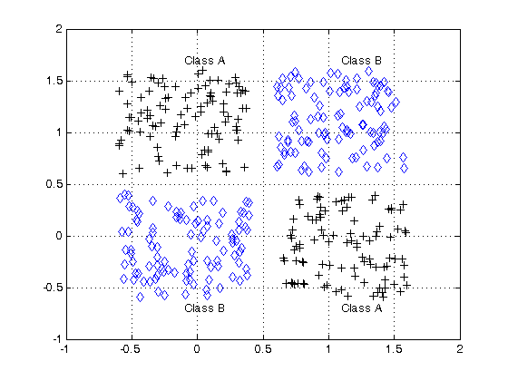
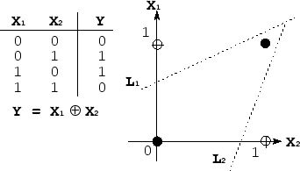
Evolution of ANNs and Emergence of Deep Learning Paradigm
After 2012: NN-based formulation of the Deep Learning paradigm demonstrated its superiority over other approaches in ImageNet competition. This started explosive growth of Deep NNs (DNNs) applications in computer vision, bioinformatics, healthcare, fundamental sciences, and business.
80-s: Creation of backpropagation algorithm for MLP training. Resurgence of interest in ANNs and NN-based applications. Besides MLP, other configurations such as Recurrent NNs and unsupervised NN-based clustering (SOM) have been studied and used in real applications.
Late 50-s: Single-Layer Perceptron (one of the first ANNs) and Linear Separability Problem (XOR Example).

Slide 9
NN Training: Dimensionality Curse
Increase of number of factors (inputs) in any model specification requires more training data for the adequate estimation of the model: Number of data samples per model parameter / factor should not dramatically decrease. In practice, this could easily lead to severe data incompleteness.
In NN context, increase of problem dimensionality leads to direct increase in the number of weights (more nodes in the input layer). Therefore, error function in the high-dimensional space becomes more complex with increasing number of hard-to-avoid local minima.

Slide 10
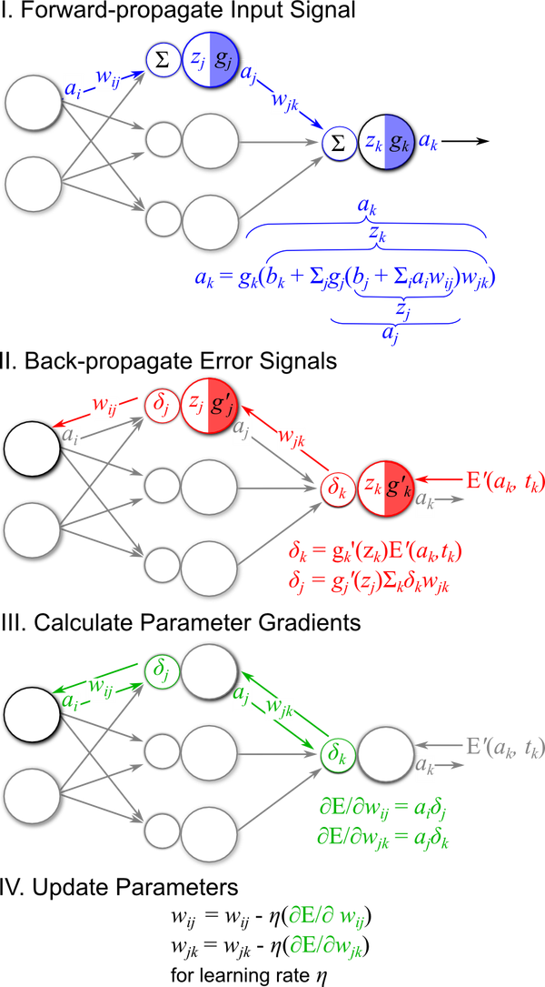
NN Training: Backpropagation (backward propagation of errors)
,
The main concept underlying the backpropagation algorithm: for a given observation one determines the degree of “responsibility” that each network parameter has for wrong prediction of a target value and parameters are changed accordingly to reduce NN error.
Step 1: To determine the network error, the observed input propagates forward through the NN layers.
Step 2:
The algorithm calculates the network output error E and the error signal δ_{κ} which backpropagates towards the input. δ_{κ} weights the gradient of the error function by the gradient of the output activation function.
Backpropagation of the error signal continues toward the input by passing δ_{κ} through the output layer weights w_{jk}, summing over all output nodes, and passing the result through the gradient of the activation function at the hidden layer g_{j}'(z_{j}).
Finally, error signal for a hidden layer is obtained. Continue for other hidden layers if more than one.
Step 3: Calculate the error function gradients with respect to the model parameters at each layer l using the forward signals a at layer (l-1) and the backward error signal d at layer l. This procedure is closely related to the concept of Hebbian learning in neuroscience.
Step 4: Update the model parameters (i.e. weights) according to the gradients calculated in step 3 and using chosen learning rate.

Slide 11

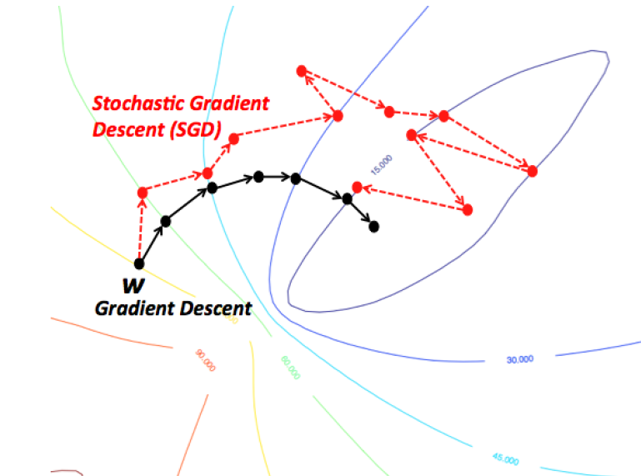
Stochastic Gradient Descent (SGD)
ANN training via backpropagation is formalized as stochastic gradient descent (SGD).
The iterative NN training is done by presenting known input-output pairs (training samples), calculating the NN error and updating the weights as follows:
Learning rate and momentum are user defined parameters.
Updating weights after each sample could often cause excessive noise in the training procedure and results in much slower convergence.
Therefore, epoch (batch) training is often used in practice, where error keeps accumulating but weight update is done only after “epoch” of N samples. Optimal value of epoch size N is problem dependent (could easily be several hundreds or more).

Slide 12
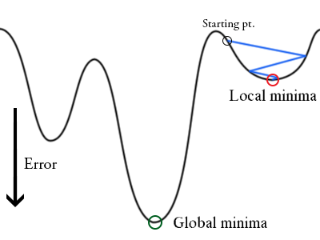
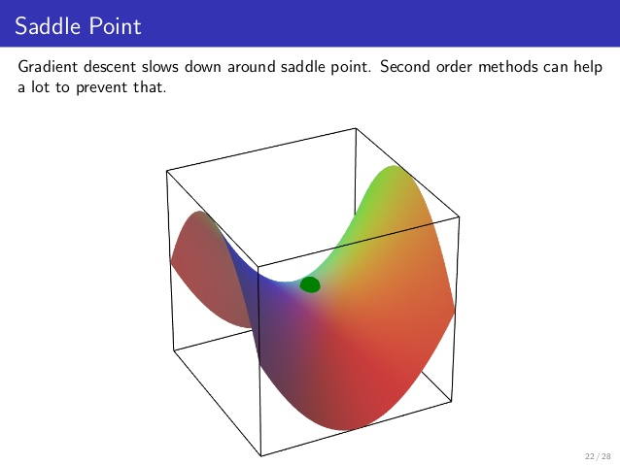
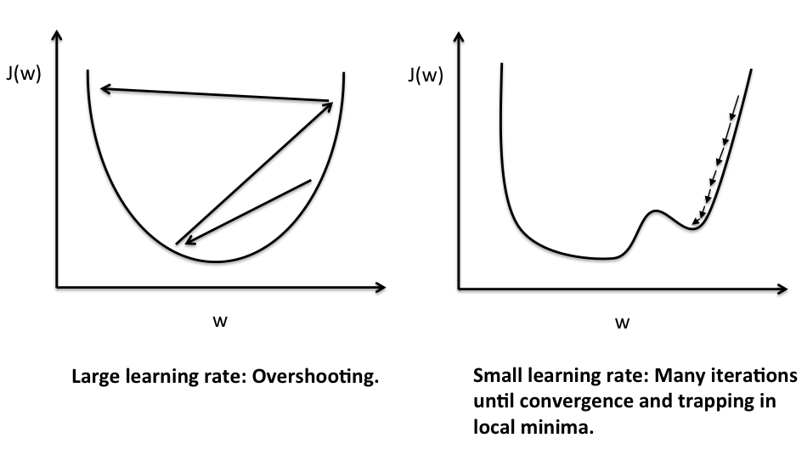
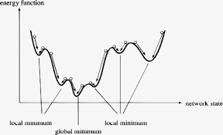
Stochastic Gradient Descent: Practical Challenges
Saddle Point
Stochasticity helps to escape from saddle points, which present a real obstacle for regular gradient descent methods (gradient is zero there!)
However, finding optimal SGD parameters to avoid such problems as “trap in local minima” or “very noisy and slow convergence (if any)” could be tricky.

Slide 13
Year 2012: Deep learning approaches received high-visibility recognition
ImageNet Large Scale Visual Recognition Competition (ILSVRC)

Slide 14
Deep Learning (DL) Paradigm and NN-based Implementations
Deep learning is not just ANN with large number of hidden layers, it is important paradigm realizing importance of hierarchical representation of data with increasing degree of abstraction.
This is paradigm is not new:
In fundamental sciences, theoretical frameworks are often focused on different spatio-temporal scales and account for interaction (energy flow) across these scales.
In traditional ML, process of feature selection could often include such hierarchical representation.
Boosting-like ensemble learning algorithms are intrinsically hierarchical: starting from global scale model at first iteration and focusing on more detailed modeling of sub-populations and sub-regimes on subsequent iterations.
NN-based implementation of DL paradigm is not the only choice. For example, multiple levels of boosting or other multi-level combinations of non-NN algorithms would be exactly inline with DL principle.
However, deep NN (DNN), implemented according to DL principles, provides universal framework for modeling complex and high-dimensional data.
Especially attractive DNN’s feature is that all stages of data-driven modeling (features selection, data transformation, and classification / regression) are covered by a single framework, i.e., potentially, user can start with raw data.
Well-chosen DNN structure and unit types self-consistently incorporate best ideas and implementations of existing ML and other algorithms (supervised, unsupervised, advanced filters, etc).
However, such universality of DNN-based approach comes with a “price” of significantly increased requirement for training data size and training time. Therefore, DNN may not be the optimal choice for a particular problem, especially in situations with severe data incompleteness or limited computational resources.

Slide 16
Practically Important Types of DNNs: Convolutional NN (CNN)
In computer vision and image recognition, the typical choice is deep CNN.
It combines many layers of convolutional network (based on principles of visual cortex operation in nature) and classification block based on standard multi-layer MLP or other suitable algorithm
Increasing Abstraction & Decreasing Variability

Slide 17
Practically Important Types of DNNs: Convolutional NN (CNN)

Slide 18
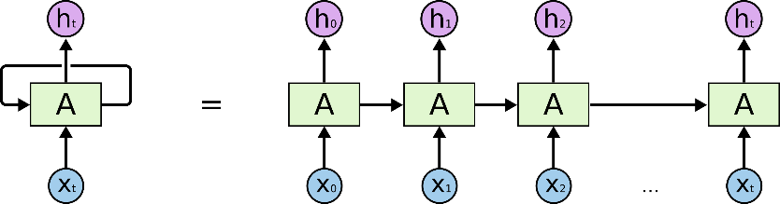
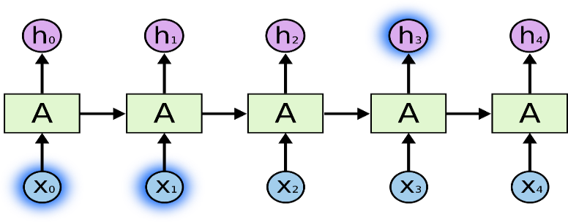
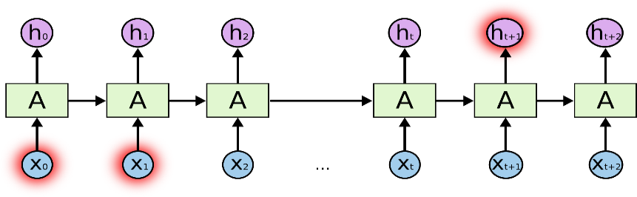
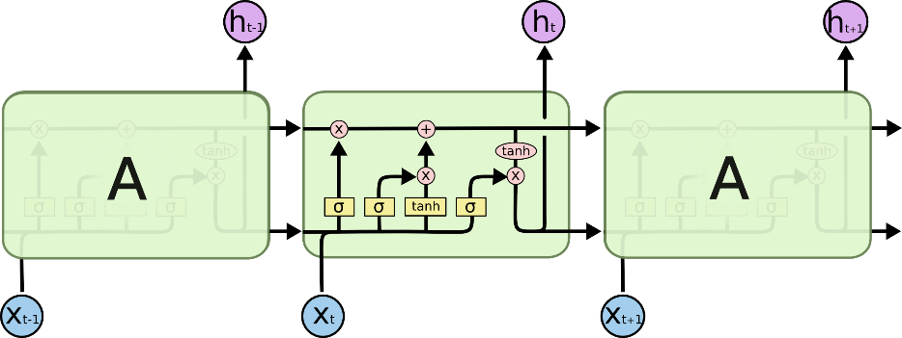
Recurrent NNs: Long Short-Term Memory (LSTM) and Gated Recurrent Unit (GRU)
Unrolled single-layer RNN
While MLP could be used for modeling time series (and other sequences) by presenting fixed-size sliding window at the input, it is not suitable to capture long-term or variable memory effects and depend on external choice of the window size (e.g. by domain expert).
RNNs take one point at a time and predict the next point: either time series or character sequence as in Natural Language Processing (NLP). During training, RNN build their own short- and long-term memory, and use it during prediction.
In theory, RNNs can have very long-term memory and efficiently use it in prediction.
However, in practice, RNNs often suffer from vanishing (or exploding) gradient problem in BPTT algorithm, and long-term memory may not be that ideal.
Modern solutions to RNNs problems:
Long Short-Term Memory (1997) - explicitly designed to avoid the long-term dependency problem.
Gated Recurrent Unit (2014) – simplified LSTM.
Good short-term memory:
“the clouds are in the sky”
Problem with long-term memory:
“I grew up in France… I speak fluent French.”
LSTM 4-layer structure with memory cells

Slide 19
Deep Learning and DNNs: Advantages, Challenges, and Solutions
DNNs are very flexible universal approximators that implement all modelling stages starting from raw data.
However, DNNs offer advantage over other approaches only in cases with large sets of training data.
To overcome data limitations several techniques for data augmentation ae used ranging from simple manipulations with original images (rotation, shifting, flipping, cropping, etc) in computer vision applications to generation of realistic synthetic data as in self-driving vehicles applications.
The other important technique critical for DNN success in situations with limited training data is learning transfer that can be used in several different ways:
If DNN is trained on the large set of somewhat relevant data and current data set is large enough, use pretrained DNN as initial weight set and further train full DNN on the current data.
If DNN is trained on the large set of relevant data (e.g. millions of images from ImageNet), and current data set (e.g. special condition medical images) is limited, start with pre-trained DNN and train only fully-connected part (i.e. classifier) or even replace it with SVM or Linear Model. Keep features / auto-encoder part as is.
If DNN is trained on the large set of less relevant data and current data set is limited for full re-training, retrain only upper (mostly abstract) layers of the auto-encoder and classification / regression part.
Finding optimal hyper-parameters of the DNN (including its structure) is very serious computational challenge that requires training large number of DNNs and choose one (or several) at the end.

Slide 20
Data Augmentation Example: Synthetic Data in Self-Driving Vehicle Applications

